Slide 1



RIGIDITY PROPERTIES OF THIN ELASTIC SHEETS BASED ON FOLDING PATTERNS
David Simmons
Shankar Venkataramani, Ph.D.
Department of Mathematics
Space Grant Consortium
The University of Arizona
April 16th, 2016

Slide 2
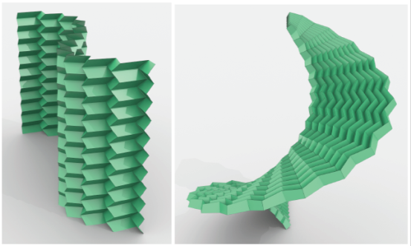
Overview
Study the relationship between folding patterns of thin elastic sheets and the resulting rigidity
Classify how many degrees of freedom a given configuration possesses
  Random or fixed pattern
Model their properties mathematically
Further develop the theory
Computational and analytical methods have proved fruitful
Source: Programming curvature using origami Tessellations
Levi H. Dudte, Etienne Vouga, Tomohiro Tachi and L. Mahadevan

Slide 3
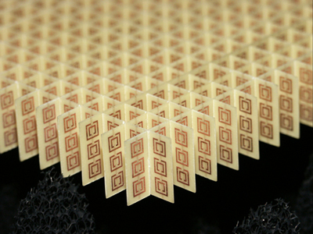
Metamaterials
Materials that possess properties not occurring in nature
Properties not derived from physical compounds but rather a repeated geometric pattern
Manipulate optical, acoustic, electromagnetic, structural properties
  Mechanical properties
Myriad of applications in science and engineering
Source: www.mat.ucsb.edu

Slide 4
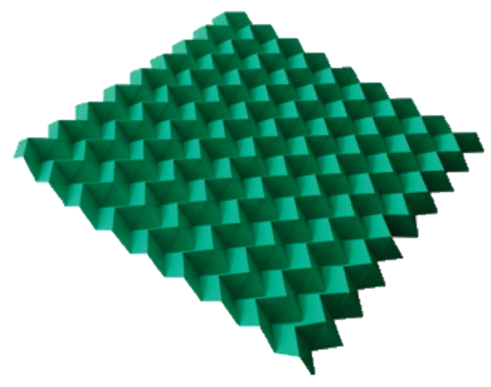
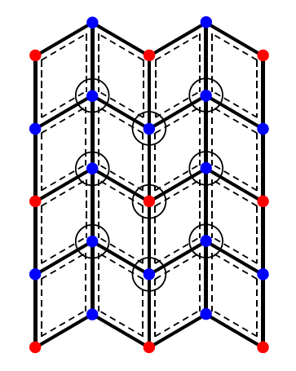
Miura-Ori Tessellation
Developed by astrophysicist Koryo Miura in 1980s
Rigidly foldable
  One degree of freedom
Application for packing and deploying solar panels in space
Auxetic: When stretched they expand perpendicularly to the applied force
Source: Programming curvature using origami Tessellations
Levi H. Dudte, Etienne Vouga, Tomohiro Tachi and L. Mahadevan

Slide 5
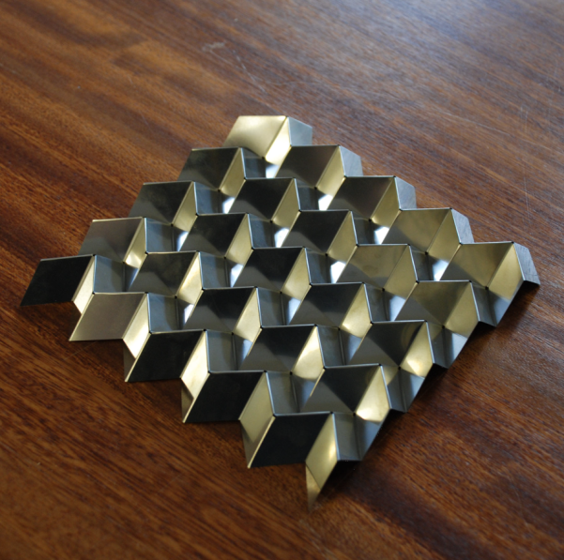
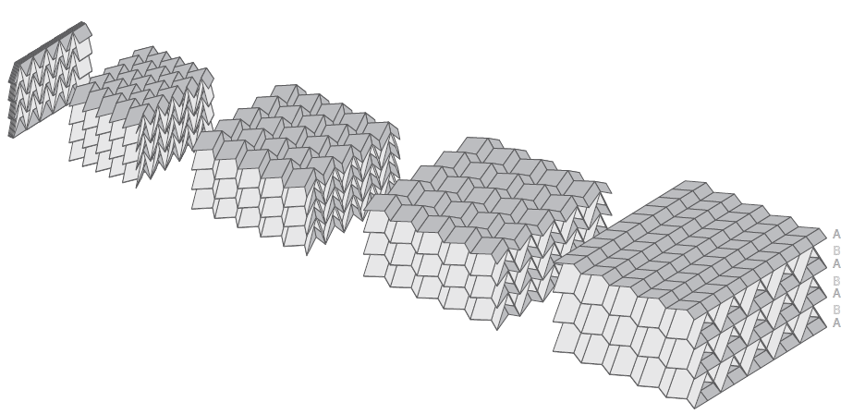
Steel Miura-Ori
Source: Geometry of Miura-folded metamaterials
Mark Schenk and Simon D. Guest

Slide 6
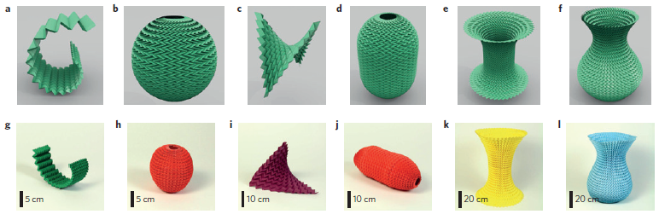
Programmable Curvature
Source: Programming curvature using origami Tessellations
Levi H. Dudte, Etienne Vouga, Tomohiro Tachi and L. Mahadevan
Create folding patterns which are moldable to specific shapes
Current results are primarily produced numerically
Not much theory has been developed

Slide 7
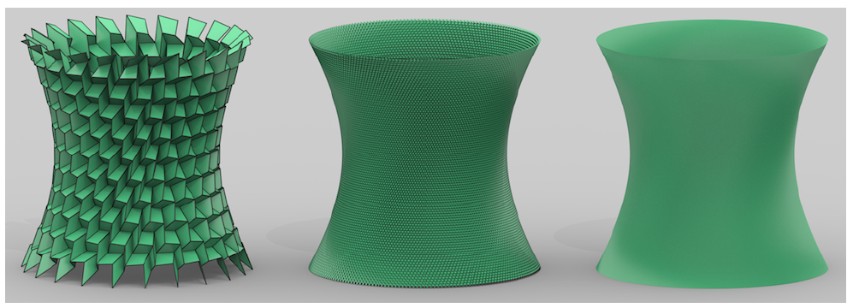
Programmable Curvature
Source: Programming curvature using origami Tessellations
Levi H. Dudte, Etienne Vouga, Tomohiro Tachi and L. Mahadevan
Approximate a variety of shapes
  Dependent on a discrete number and size of faces
Find a limiting equation where the approximation converges to the modelled shape

Slide 8
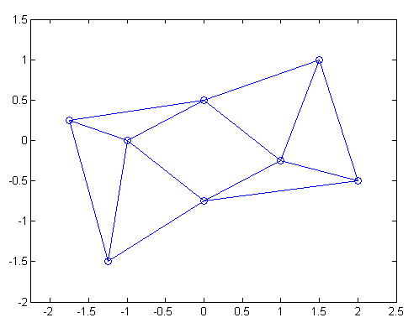
Methods
  Goal: Compute the number of degrees of freedom of a given configuration
  Patterns are representable as mathematical graphs
    Nodes and edges
Analytical approach
  Linear algebra
  Lie algebra/groups

Slide 9
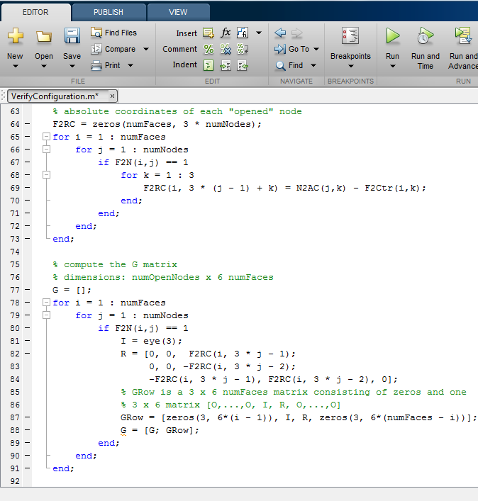
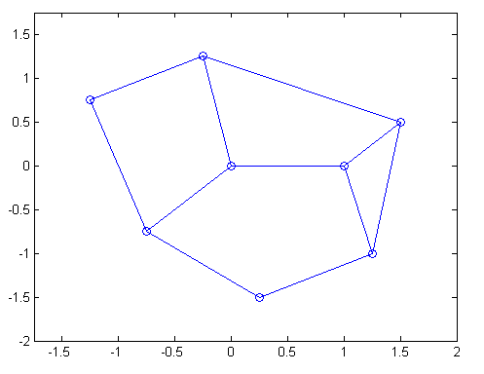
Preliminary Results
Implemented in MATLAB
  Calculated anticipated degrees of freedom successfully

Slide 10
Moving Forward
Work-in-progress
Use an analytical approach to develop equations modelling the limiting process
  Bridge the gap between the discrete math of the folding pattern and the continuous math of the desired shape

Slide 11
Acknowledgements
Dr. Venkataramani
NASA Space Grant
Space Grant Team
Andrea Parber and Peer Mentors
Fellow Space Grant Interns

Slide 12
Thank You

